Slide 1
THE CONCEPT OF SUPPLY
NAPINDER KAUR
Assistant Professor

Slide 2
LEARNING OUTCOMES
After the lecture you will be able to:
Understand the concept of supply
Compare different determinants of supply also.

Slide 3
SUPPLY
Supply refers to the quantities of a good or service that the seller is willing and able to provide at a price, at a given point of time, ceteris paribus.

Slide 4
DETERMINANTS OF SUPPLY
Price of the commodity
Cost of production
State of technology
Number of firms
Government policies

Slide 5
SUPPLY FUNCTION
Supply of a product is a function of:
S_{x} = f(Px, C, T, G, N)
A firm’s supply function for good X can be simplified by holding constant the values of all variables other than price of a good, as follows:
S = f(P)
S_{x} = c + dPx

Slide 6
LAW OF SUPPLY
The law of supply states that other things remaining the same, the higher the price of a commodity, the greater is the quantity supplied.

Slide 7
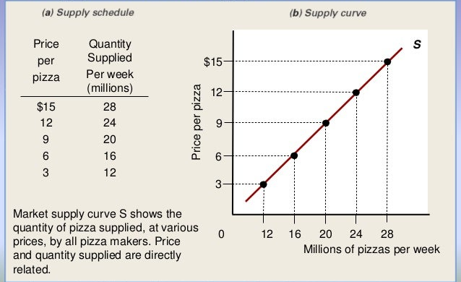
SUPPLY SCHEDULE AND SUPPLY CURVE

Slide 8
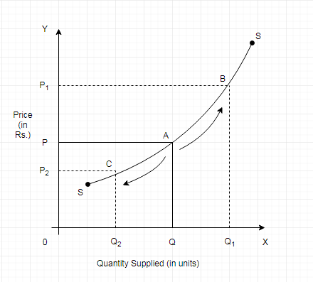
MOVEMENTS ALONG THE SUPPLY CURVE

Slide 9
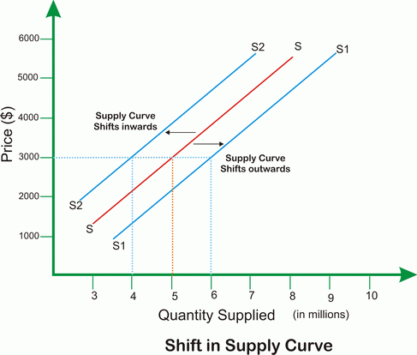
SHIFTS IN THE SUPPLY CURVE
Due to non-price determinants of supply.

Slide 10
THINK ABOUT IT
What would happen if the number of firms producing a commodity in the economy increases?
The aggregate demand curve would shift to the left.
The aggregate supply curve would shift to the left.
The aggregate supply curve would shift to the right.
The aggregate supply curve would remain unchanged.

